Slide 1

Data Visualization of Bird Strikes between 2000 – 2011
Power BI Project
By Pranjal Chavle

Slide 2

Table of Contents
Problem Statement
Variable Description
Introduction
Important KPS’s
Snapshots of Dashboard’s

Slide 3


Problem Statement:
Transport and communication are crucial in analytics, especially regarding environmental impacts and safety in urban areas. Increasing vehicles and people demand innovative solutions, with artificial intelligence and Multi-Agent Systems (MAS) gaining recognition. A significant threat to aviation safety is bird strikes, collisions between birds and aircraft, including wildlife strikes involving bats and ground animals. Bird strikes can cause severe damage, particularly to jet engines, leading to engine failure and potential fatal accidents. These incidents are most likely during take-off, climb, approach, and landing due to higher bird activity at lower altitudes. FAA data from 2000 to 2011 highlights the frequency and impact of bird strikes, emphasizing the need for effective mitigation strategies to enhance aviation safety.

Slide 4

Variable Description:
Record ID: Unique identifier for each record.
Aircraft: Type: Type of aircraft involved.
Airport: Name: Name of the airport.
Altitude bin: Altitude range where the strike occurred.
Aircraft: Make/Model: Make and model of the aircraft.
Wildlife: Number struck: Number of wildlife struck.
Wildlife: Number Struck Actual: Exact number of wildlife struck.
Effect: Impact to flight: Impact of the strike on the flight.
FlightDate: Date of the flight.
Effect: Indicated Damage: Indicated damage to the aircraft.
Aircraft: Number of engines?: Number of engines on the aircraft.

Slide 5

Variable Description Continued :
Aircraft: Airline/Operator: Airline or operator of the aircraft.
Origin State: State of origin of the flight.
When: Phase of flight: Flight phase during the strike.
Conditions: Precipitation: Precipitation conditions during the strike.
Remains of wildlife collected?: Whether remains were collected.
Remains of wildlife sent to Smithsonian: Whether remains were sent to Smithsonian.
Remarks: Additional comments or remarks.
Wildlife: Size: Size of the wildlife struck.
Conditions: Sky: Sky conditions during the strike.

Slide 6
Introduction:
Collisions between birds and aircraft are known as "bird strikes," and they represent a serious risk to aviation safety. The FAA gathered this dataset from 2000 to 2011, and it includes extensive information about bird strikes, such as the kind and model of aircraft, height, quantity of animals struck, effect on flights, and expenses and damages incurred. We hope to find patterns and trends in this data that can assist reduce bird strikes and improve aviation safety. Important characteristics include the wildlife involved, the surroundings, and the specifics of the flight phases during strikes. By using data analytics, we can create plans to lessen the severity and frequency of bird strikes, which will increase aviation industry safety and cut expenses.

Slide 7
Important KPI’s:
Total Number of Bird Strike
Bird Strike per Year
Number of Bird Strike by Top 50 Airports
Top 10 Airlines that Encountered Bird Strike
Yearly Cost Incurred due to Bird Strike
Phase of Flight when Bird Strike Occur
Prior Warnings to the Pilots
Indicated Damage to Bird Strike
Effect on Flight due to Bird Strike
Number of Bird Strike by Top 20 Aircraft Models
Top 10 Bird Strike States
Yearly Bird Strike number based on their Species

Slide 8
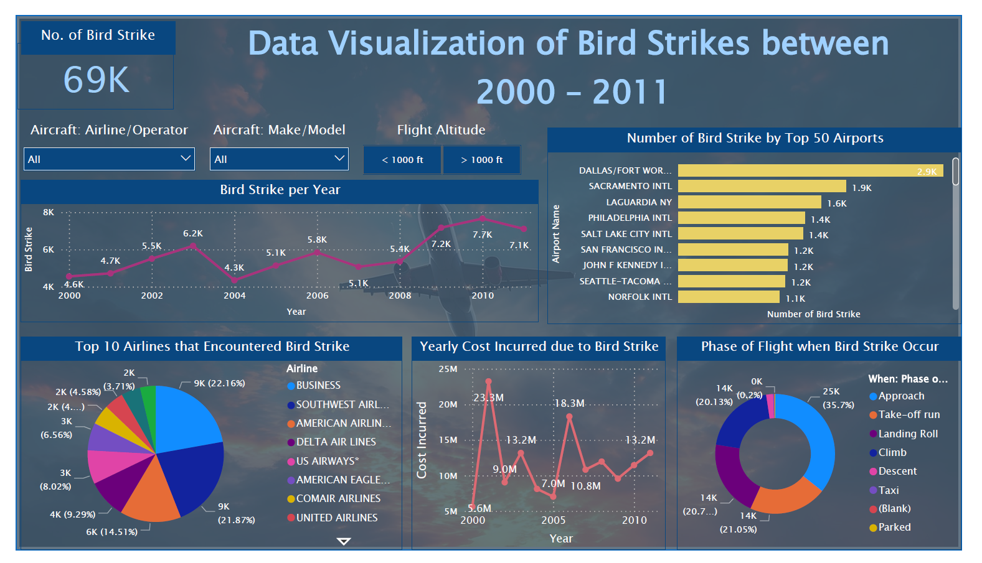
Dashboard Snapshots:

Slide 9
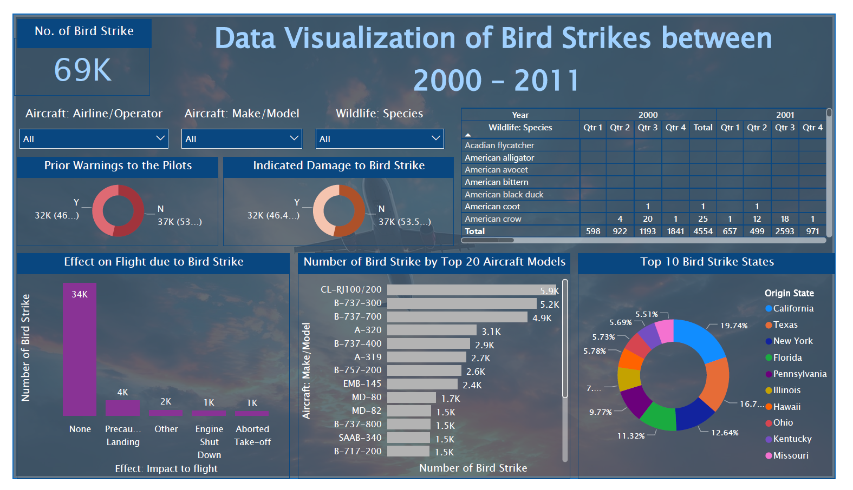
Dashboard Snapshots:

Slide 10

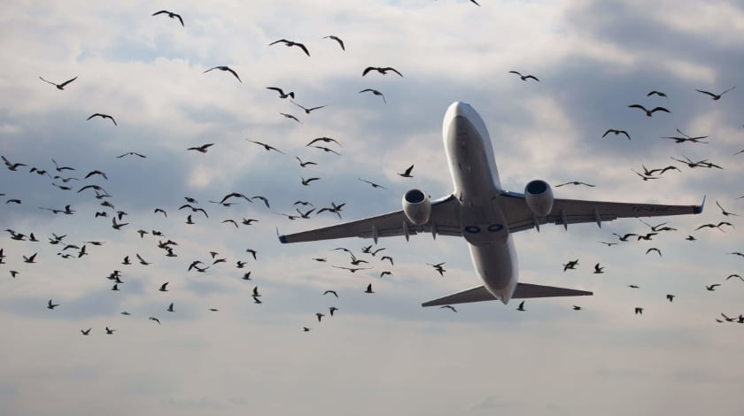
Thank You

